Slide 1
How to find AMAT In a multi-level cache
An Example

Slide 2
Qualcomm Snapdragon Flagship SoCs 2018-2019
SoC | Snapdragon 845 | Snapdragon 855
CPU | 4x Kryo 385 Gold (A75 derivative) @ 2.8GHz 4x256KB L2 4x Kryo 385 Silver (A55 derivative) @ 1.80GHz 4x128KB L2 2MB L3 | 1x Kryo 485 Gold (A76 derivative) @ 2.84GHz 1x512KB pL2 3x Kryo 485 Gold (A76 derivative) @ 2.42GHz 3x256KB pL2 4x Kryo 485 Silver (A55 derivative) @ 1.80GHz 4x128KB pL2 2MB sL3 @ 1612MHz
GPU | Adreno 630 | Adreno 640 @ 585MHz
Memory | 4x 16-bit CH @ 1866MHz LPDDR4x 29.9GB/s 3MB system cache | 4x 16-bit CH @ 2092MHz LPDDR4X 33.4GB/s 3 MB system level cache
Mfc. Process | 10nm LPP | 7nm LPE

Slide 3
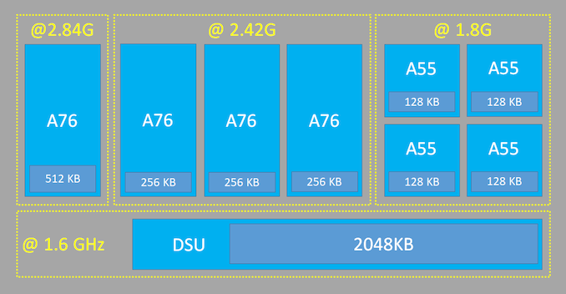
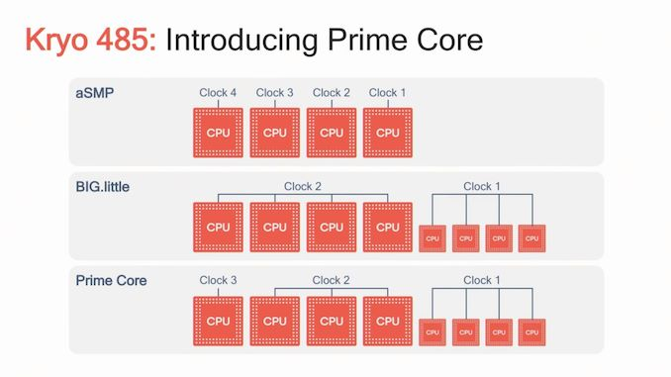

Slide 4
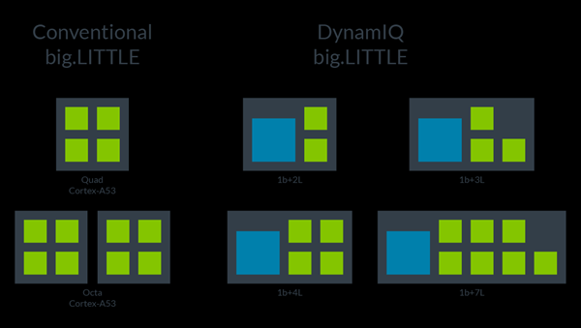

Slide 5
Let us look at Snapdragon 800 chipset cache
ARM cortex A 15 processor has 32kB of instruction and 32kB of data L1 cache. L2 cache is a unified cache of size 4 MB
Qualcomm krait 800 has three levels of cache; L0, L1 & L2
Samsung Galaxy 6
Cache | Size | Architecture | Frequency
L0 | 4KB + 4KB | Direct mapped | Core
L1 | 16KB+16KB | 4-way set associative | Core
L2 | 1MB (Dual core) or 2MB (Quad core) | 8-way set associative | 1.3GHz max

Slide 6
General Formula
AMAT = Time for a hit + miss rate X miss penalty
What if we have a two level cache, L1 and L2?
AMAT =
Time for L1 hit +
miss rate of L1 x
{ time for L2 hit +
(miss rate of L2 x L2 miss penalty)}

Slide 7
Memory Hierarchy
Main
Memory
L2
Unified
Cache
L1
I $
Processor
L1
D$

Slide 8
Problem Statement
A certain system with a 500 MHz clock uses a Harvard architecture (separate data and instruction caches) at the first level, and a unified second-level cache. The first-level data cache is a direct-mapped, write-through, writes-allocate cache with 8 Kbytes of data total and 8-Byte blocks, and has a perfect write buffer (never causes any stalls).
The first-level instruction cache is a direct-mapped cache with 4KBytes of data total and 8-byte blocks. The second-level cache is a two-way set associative, write-back, write-allocate cache with 2MBytes of data total and 32-Byte blocks.

Slide 9
Contd:
The first-level instruction cache has a miss-rate of 2%. The first-level data cache has a miss-rate of 15%. The unified second-level cache has a local miss rate of 10% (i.e. the miss rate for all accesses going to the second-level cache). Assume that 40% of all instructions are data memory accesses; 60% of those are loads, and 40% are stores. Assume that 50% of the blocks in the second-level cache are dirty at any time. Assume that there is no optimization for fast reads on an L1 or L2 cache miss.

Slide 10
Contd.
All first-level cache hits cause no stalls. The second-level hit time is 10 cycles (That means that the L1 miss-penalty, assuming a hit in the L2 cache, is 10 cycles). Main memory access time is 100 cycles to the first bus width of data; after that, the memory system can deliver consecutive bus widths of data on each following cycle. Outstanding, non-consecutive memory requests can not overlap; an access to one memory location must complete before an access to another memory location can begin. There is a 128-bit bus from memory to the L2 cache, and a 64-bit bus from both L1 caches to the L2 cache. Assume that the TLB never causes any stalls.

Slide 11
Questions…
What fraction of all data memory references cause a main memory access (main memory is accessed before the memory request is satisfied)? First show the equation, then the numeric result.
How many bits are used to index each of the caches ie Instruction, Data and L2 ?
What is the average memory access time in cycles (including instructions and data memory references)? First show the equation, then the numeric result. Hint: don’t forget to consider dirty lines in the L2 cache.

Slide 12
Problem Statement (easy to read)
A certain system with a 500 MHz clock uses a Harvard architecture (separate data and instruction caches) at the first level, and a unified second-level cache. The first-level data cache is a direct-mapped, write-through, writes-allocate cache with 8 Kbytes of data total and 8-Byte blocks, and has a perfect write buffer (never causes any stalls).
The first-level instruction cache is a direct-mapped cache with 4KBytes of data total and 8-byte blocks. The second-level cache is a two-way set associative, write-back, write-allocate cache with 2MBytes of data total and 32-Byte blocks.

Slide 13
Contd:
The first-level instruction cache has a miss-rate of 2%. The first-level data cache has a miss-rate of 15%. The unified second-level cache has a local miss rate of 10% (i.e. the miss rate for all accesses going to the second-level cache). Assume that 40% of all instructions are data memory accesses; 60% of those are loads, and 40% are stores. Assume that 50% of the blocks in the second-level cache are dirty at any time. Assume that there is no optimization for fast reads on an L1 or L2 cache miss.

Slide 14
Contd.
All first-level cache hits cause no stalls. The second-level hit time is 10 cycles (That means that the L1 miss-penalty, assuming a hit in the L2 cache, is 10 cycles). Main memory access time is 100 cycles to the first bus width of data; after that, the memory system can deliver consecutive bus widths of data on each following cycle. Outstanding, non-consecutive memory requests can not overlap; an access to one memory location must complete before an access to another memory location can begin. There is a 128-bit bus from memory to the L2 cache, and a 64-bit bus from both L1 caches to the L2 cache. Assume that the TLB never causes any stalls.

Slide 15
Questions…
What fraction of all data memory references cause a main memory access (main memory is accessed before the memory request is satisfied)? First show the equation, then the numeric result.
How many bits are used to index each of the caches ie Instruction, Data and L2 ?
What is the average memory access time in cycles (including instructions and data memory references)? First show the equation, then the numeric result. Hint: don’t forget to consider dirty lines in the L2 cache.

Slide 16
Our example
100 cycles Penalty
10 cycles Penalty
Main
Memory
L2
Unified
Cache
2MB
L1
I $
4KB
Processor
L1
D$
8KB
64 bit bus
128 bit bus

Slide 17
How to interpret data
L1 Data Cache
Size 8 KB
Block size 8 byte
Direct mapped
Write through
Write allocate
Miss rate = 15%
L1 Instruction Cache
Size 4 KB
Block size 8 byte
Direct mapped
Miss rate = 2%
L2 Unified Cache
Size 2MB
Block size 32 byte
Two way set-assoc.
Write back
Write allocate
Miss rate = 10%
60% of which are loads
40% of all instructions are
data memory accesses
40% of which are stores
Assume that 50% of the blocks in L2 are dirty at any time

